Slide 1

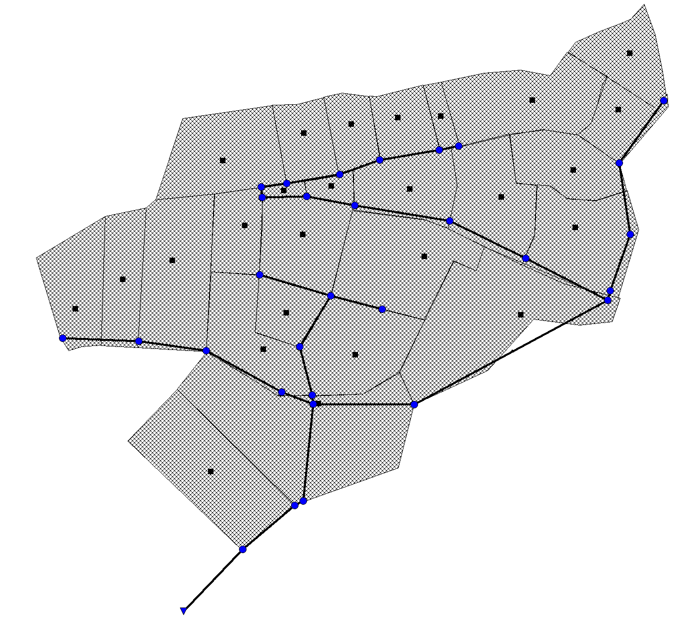






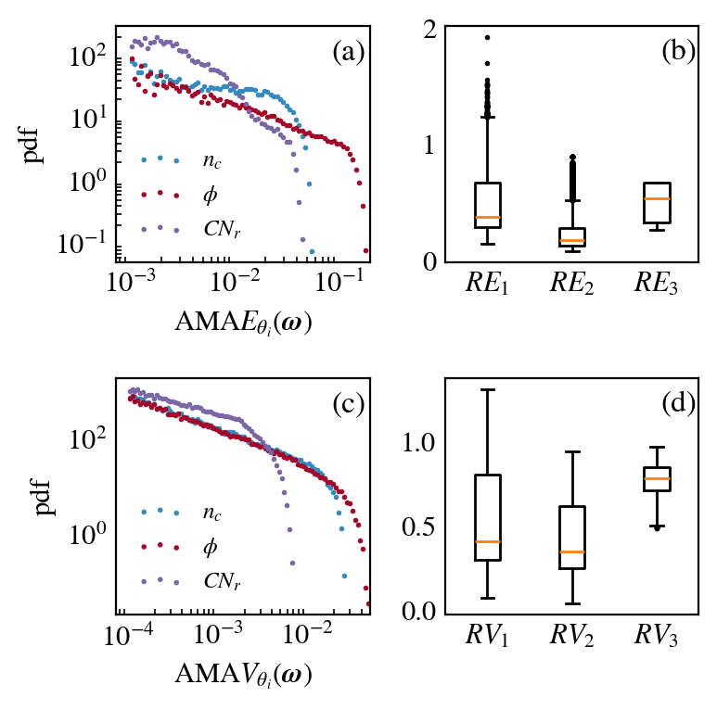

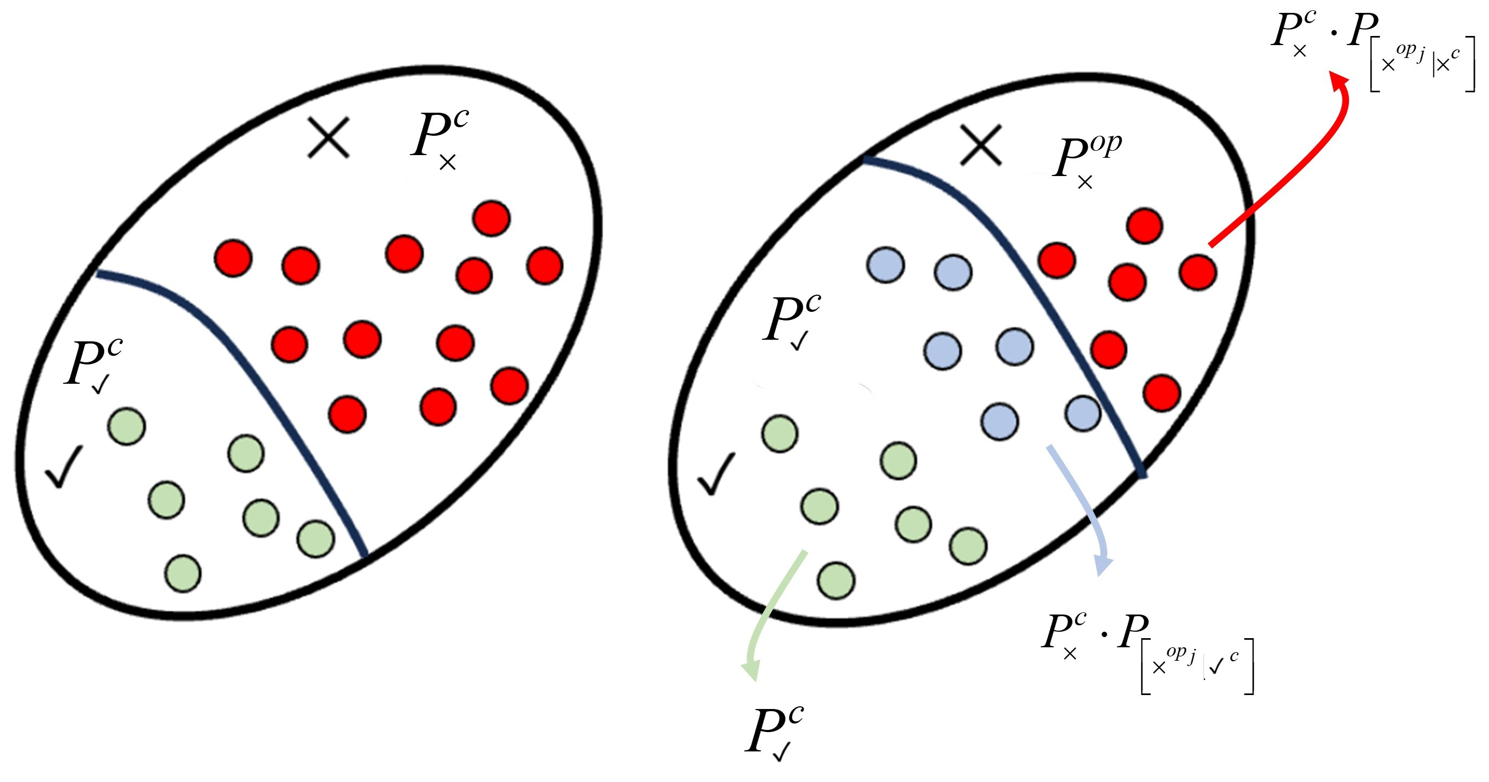


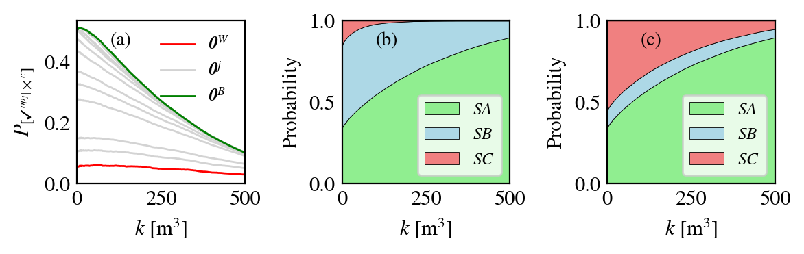

flood
You can only
modify some variables!
flood
flood
flood
Need an intervention
Read this paper of Operational Sensitivity Analysis!
How do I decide which operational variable to intervene whilst considering uncertainty of stochastic variables?
Stochastic variables
Rain
Operational variables
Pipes

